Slide 1
Scalability
Lecturer: Ngo Huy Bien
Software Engineering Department
Faculty of Information Technology
VNUHCM - University of Science
Ho Chi Minh City, Vietnam
nhbien@fit.hcmus.edu.vn

Slide 2

Objectives

Slide 3

Contents
Scalability Concepts

Slide 4

References
Bill Wilder (2012). Cloud Architecture Patterns: Using Microsoft Azure. O'Reilly Media.
Frederick Chong and Gianpaolo Carraro (2006). Architecture Strategies For Catching The Long Tail.
Ahmed Soliman (2013). Getting Started with Memcached. Packt Publishing.

Slide 5
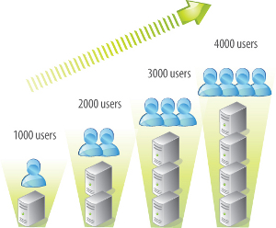
Scalability [1]
Scaling is about allocating resources for an application and managing those resources efficiently to minimize contention.
The scalability of an application is a measure of the number of users it can effectively support at the same time.
The point at which an application cannot handle additional users effectively is the limit of its scalability.

Slide 6

Scalability and Performance
Performance refers to the experience of an individual user.
The user experience (UX) is negatively impacted when an application requires more resources than are available.
Scalability impacts performance and efficiency impacts scalability.

Slide 7
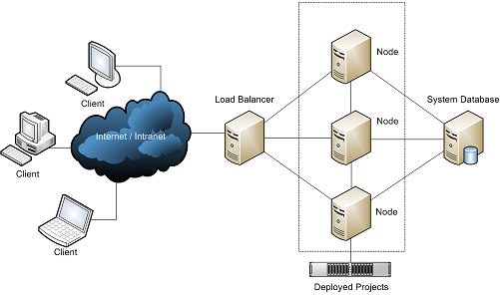
Nodes
A node might be part of a physical server (usually a virtual machine), a physical server, or even a cluster of servers, but the generic term node is useful when the underlying resource doesn’t matter.
An application runs on multiple nodes, which have hardware resources.
Application logic runs on compute nodes and data is stored on data nodes.

Slide 8
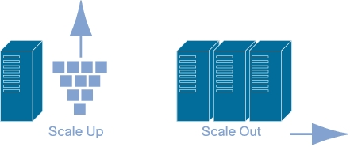
Scaling Up and Scaling Out
Application scale can be extended by providing additional hardware resources, as long as the application can effectively utilize those resources.
To vertically scale up is to increase overall application capacity by increasing the resources within existing nodes.
To horizontally scale out is to increase overall application capacity by adding nodes.
Vertical scaling is limited by the utilizable capability of available hardware.
Converting an application from vertical scaling to horizontal scaling usually requires significant changes.

Slide 9
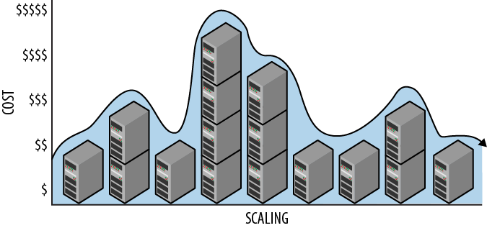
Horizontally Scaling Compute Pattern
The Horizontal Scaling Compute Pattern effectively deals with the following challenges:
Application capacity requirements exceed (or may exceed after growth) the capacity of the largest available compute node.
Application compute nodes require minimal downtime, including resilience in the event of hardware failure, system upgrades, and resource changes due to scaling.
Cloud scaling is easily reversed. Costs vary in proportion to scale as scale
varies over time.

Slide 10

Auto-Scaling
Applications designed for horizontal scaling generally have nodes allocated to specific functions.
When all the nodes supporting a specific function are configured identically—same hardware resources, same operating system, same function-specific software—we say these nodes are homogeneous.
Horizontal scaling is more efficient with homogeneous nodes.
If the nodes are homogeneous, then basic round-robin load balancing works nicely, capacity planning is easier, and it is easier to write rules for auto-scaling.
A node that does not need to communicate with other nodes of the same type in order to do its job called an autonomous node.
Autonomy is important so that nodes can maintain their own efficiency regardless of what other nodes are doing.

Slide 11
Scalability vs. High Availability
User (SPA) ---> Web server (API) ---> Database server.
User (Brower) ---> Web server (MPA/API) ---> Database server.
User (Native mobile app) ---> Web server (API) ---> Database server.
User (SPA) ---> Web server (API) 1 ---> Down.
(automated) ---> Web server (API) 2 (Backup) ---> Up.

Slide 12


Slide 13
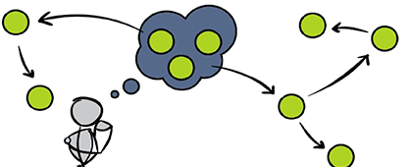
Scaling Out Guidelines (I) [2]
Statelessness means that each transaction can be handled by one instance as well as any other; a user may transact with dozens of different instances during a single session, without ever knowing it.
Design the application to run in a stateless fashion, with any necessary user and session data stored either on the client side, or in a distributed store that's accessible to any application instance.

Slide 14
Scaling Out Guidelines (II)
Design the application to conduct I/O operations asynchronously, so that the application can perform useful work while waiting for input and output to complete.
Pool resources such as threads, network connections, and database connections; this helps maximize your computing resources, and it improves your ability to predict resource usage.
Write your database operations in such a way as to maximize concurrency and minimize exclusive locking. For example, don't lock records when performing read-only operations.

Slide 16
(ASP.NET) Session Storage
Machine key should be same for both servers: View state and session both depend on the machine key.
Session storage options:
InProc
StateServer
SQLServer
<system.web>
<httpCookies requireSSL="true" />
<machineKey validation="SHA1" />
<sessionState timeout="25" cookieless="false" regenerateExpiredSessionId="true" mode="InProc" />
...

Slide 17
1. Create an SQL Server Database for SQLServer Session Mode
Run cmd.exe as Administrator
C:\Windows\Microsoft.NET\Framework\v4.0.30319\aspnet_regsql.exe -ssadd -sstype c -d apistate.example.com -S localhost –E

Slide 18
2. Create a Connection String for SQLServer Session Mode
Create web.connectionStrings.config file.
<?xml version="1.0" ?>
<connectionStrings>
<clear />
...
<add name="snsState" connectionString="Data Source=192.168.101.62;Initial Catalog=apistate.example.com;Persist Security Info=True;User ID=api.example.com;Password=$%Ym*k3xtt4#bNNu;Connect Timeout=60;Min Pool Size=0;Max Pool Size=100;" providerName="System.Data.SqlClient" />
</connectionStrings>

Slide 19
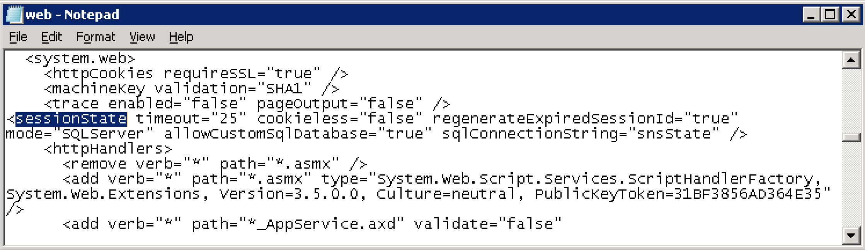
3. Enable SQLServer Session Mode
<connectionStrings configSource="web.connectionStrings.config" />
<sessionState timeout="25" cookieless="false" regenerateExpiredSessionId="true" mode="SQLServer" allowCustomSqlDatabase="true" sqlConnectionString="snsState" />

Slide 21
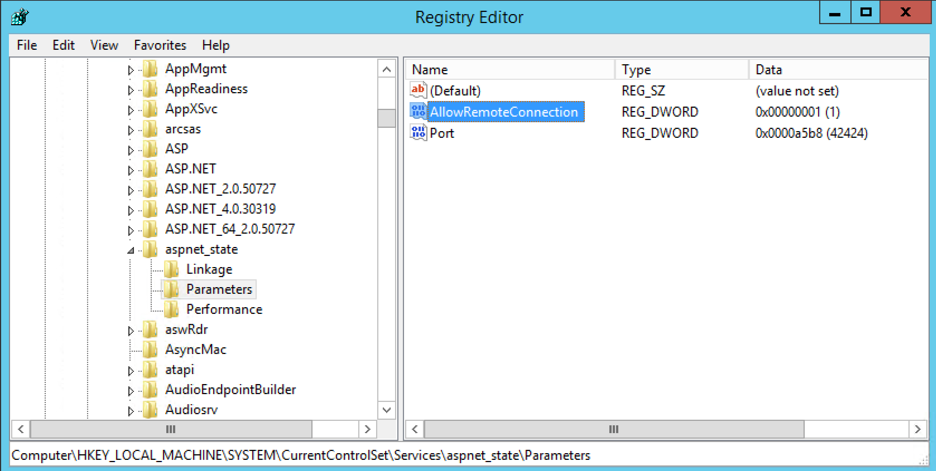
1. Enable State Service Remote Connection
HKEY_LOCAL_MACHINE\SYSTEM\CurrentControlSet\Services\aspnet_state\Parameters\AllowRemoteConnection

Slide 22
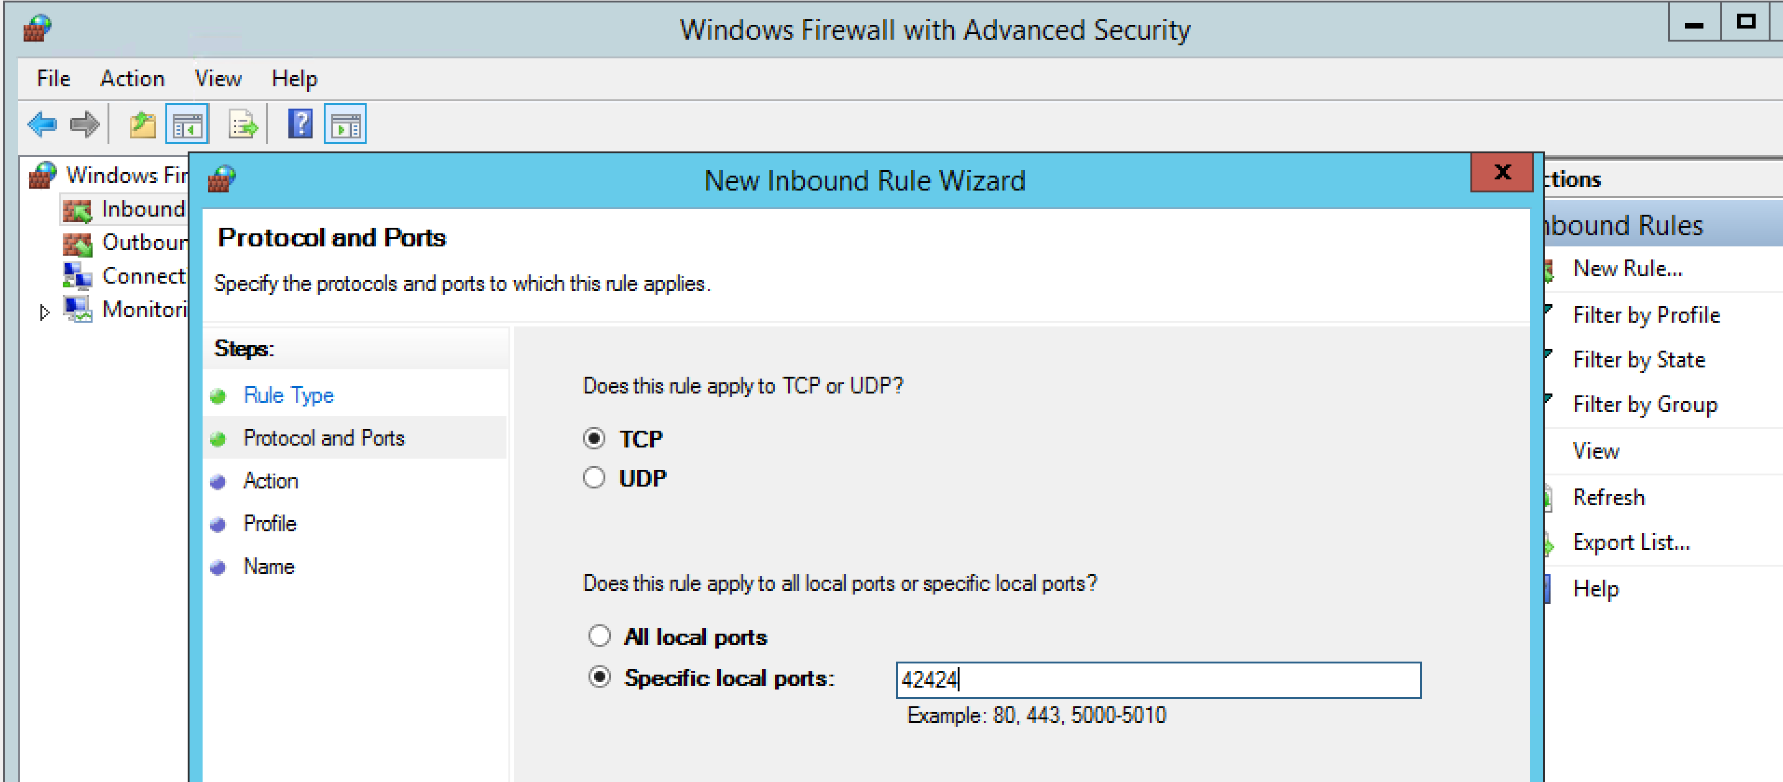
2. Open State Service Firewall Port
Port: 42424

Slide 23
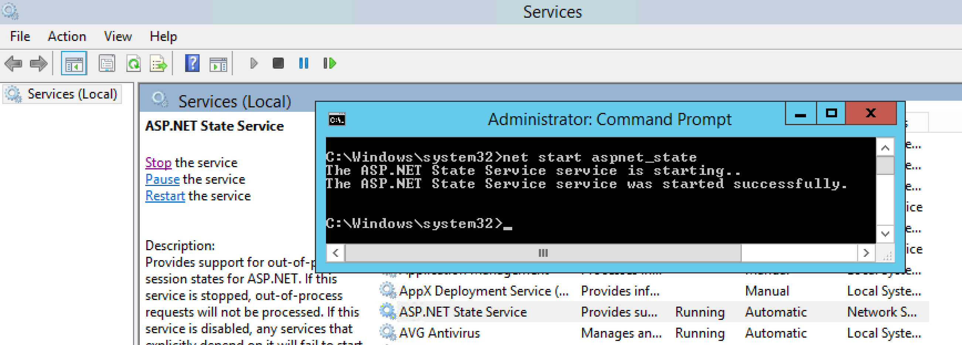
3. Start Session State Service
net start aspnet_state

Slide 24
4. Enable StateServer Session Mode
<system.web>
<httpCookies requireSSL="true" />
<machineKey validation="SHA1" />
<sessionState timeout="25" cookieless="false" regenerateExpiredSessionId="true" mode="StateServer" stateConnectionString="tcpip=192.168.101.120:42424" stateNetworkTimeout="60" useHostingIdentity="false" />
...

Slide 26
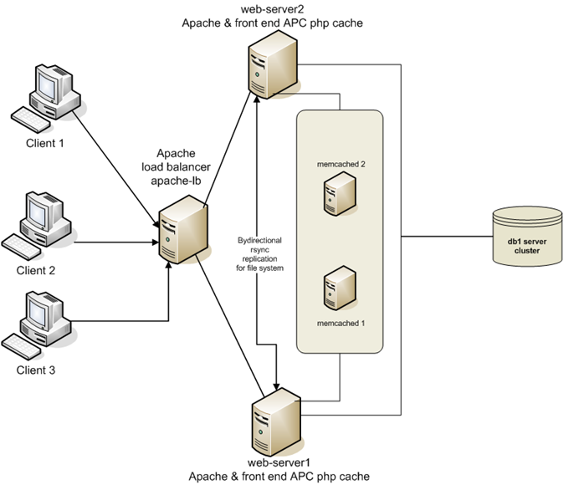
Distributed Cache [3]
https://github.com/memcached/memcached/wiki
https://redis.io/docs/getting-started/
https://codeburst.io/redis-what-and-why-d52b6829813

Slide 28
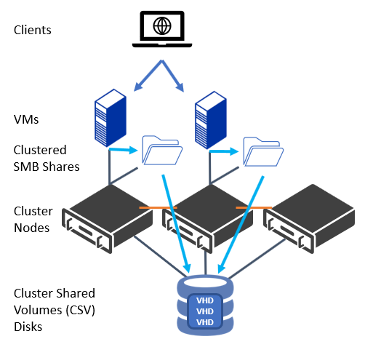
Scaling Out File Server
https://www.altaro.com/hyper-v/scale-out-file-server-hyper-v/

Slide 30


Identify a Concrete Problem
As an architect, I want the data to scale horizontally so it can serve as many clients as needed.
MongoDB (Cassandra)
mySQL
MS SQL

Slide 31
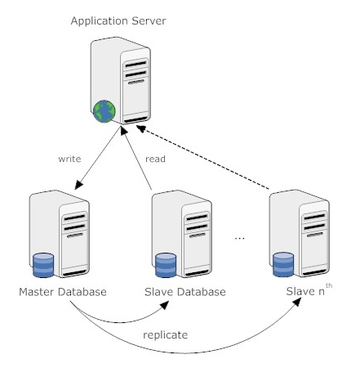
Scaling Out Database
Scaling processing
Scaling storage

Slide 32
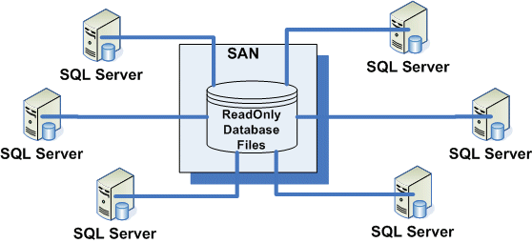
Scalable Shared Databases
You create a database on a storage area network (SAN), and up to eight SQL Server instances running on different servers attach to the database, and start handling queries.
Scalable Shared Databases work only if the database is attached as a Read Only database.
Scalable Shared Databases are great for data warehouses or reporting databases, but they are not suitable for applications that update data.

Slide 33

Linked Servers and Distributed Queries
SQL Server has the ability to query remote database objects as if they were local.
This means that a scaled out database can look like a single large database to an application.
The major change to the SQL Queries is that the table names will now include the name of the linked server where the data is located.

Slide 34
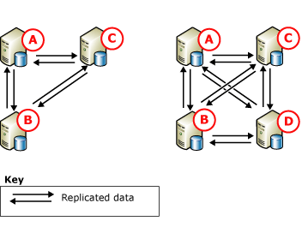
Peer-to-Peer Replication
https://docs.microsoft.com/en-us/sql/relational-databases/replication/transactional/peer-to-peer-transactional-replication?redirectedfrom=MSDN&view=sql-server-ver15
Each database engine maintains its own copy.
Replication is used to propagate changes to all copies of the data.
Peer-to-Peer replication does not provide conflict resolution, and therefore it is recommended only in configurations where only one copy of a given data element is updated.
There is always some latency involved when changes are replicated. For applications that require the latest change to be seen immediately, dynamically load balancing the application across multiple nodes can be problematic.

Slide 35
Distributed Partitioned Views (I)
The data in a table is partitioned among tables in several distributed databases, based on a partitioning key.
For example, a customer table might be partitioned on customer number ranges (1–1000 in one database, 10001–20000 in a second database, 20001–30000 in a third, and so on).
Customer ID | Database ID
115 | 1
10016 | 2
10017 | 2
20018 | 3
Example Partition Lookup Table

Slide 36
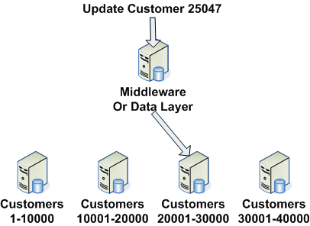
Distributed Partitioned Views (II)
The application is involved in the decision about where to execute a query.
Check the partition lookup table to identify which customers are located in which database.
A query that accesses a particular customer number will be executed only on the database that contains the desired customer number.
Queries that don't reference a particular customer number will have to be run on all the partitions.

Slide 37
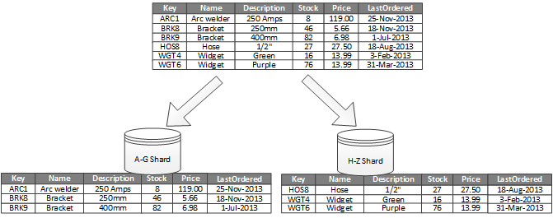
Horizontal Partitioning (Sharding)
https://docs.microsoft.com/en-us/azure/architecture/best-practices/data-partitioning
Sharding spreads the load over more computers, which reduces contention and improves performance.

Slide 38
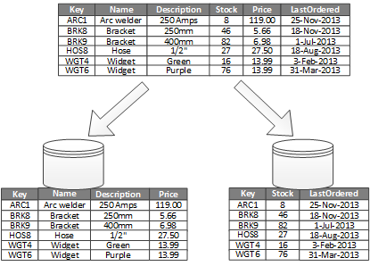
Vertical Partitioning
To reduce the I/O and performance costs associated with fetching items that are frequently accessed.

Slide 39
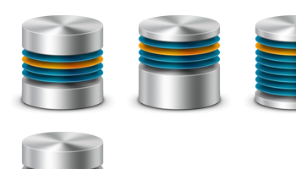
How to Repartition Data?
Have dynamic repartitioning strategies in place, to ensure that already-partitioned data can be repartitioned in order to keep up with performance and scale metrics.

Slide 40
Service-Oriented Data Architecture [2]
Using the database itself to implement services for an SOA environment is called Service-Oriented Data Architecture.
SODA uses Service Broker to deliver and queue service messages, and to manage the service processes that are implemented as CLR stored procedures.
Services can be invoked by putting a message in a Service Broker queue, either directly through a normal database connection, or through the SQL Server 2005 Web Services interface.
Split the data so that each database contains the data for the services it contains.
Multiple copies of each service database can be created, with each copy handling a data partition.

Slide 41

Thank You & See You Again

